Slide 1
The Job Explorer
— A $alary Analysis
🦌 Group Bambi：Maggie Xu, Lia Wang, Ceci Chen 🦌

Slide 2
Table of Contents
10%
Data Preprocessing & Cleaning
70%
4 Research Questions
90%
ML Models For Prediction
100%
Further Discussion

Slide 3
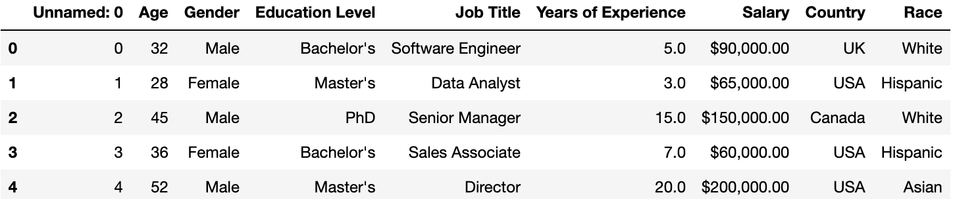
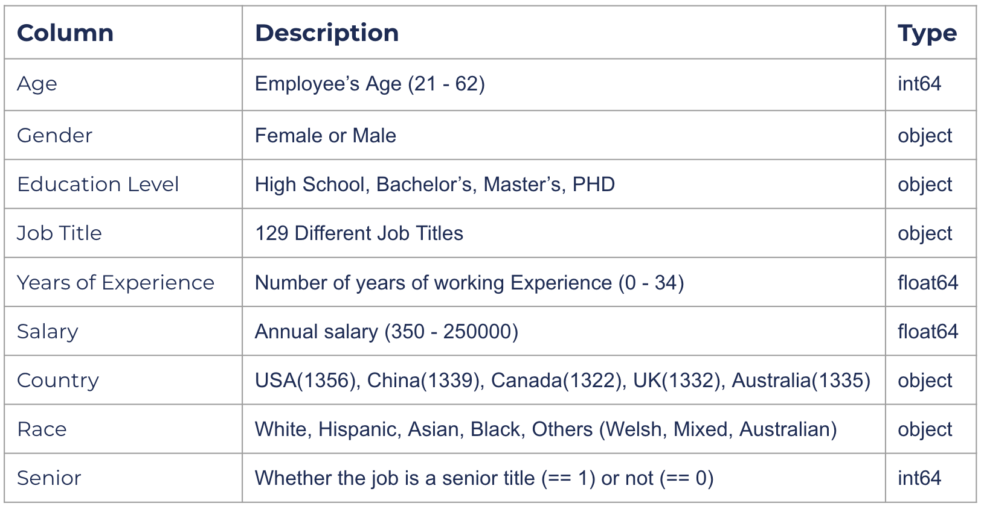
Data Preprocessing and Cleaning
Dataset Salary_data_based_on_country_and_race(2023)
Source: Hosted on Kaggle, originally compiled by VIRA SPASIVSKA
Overview: A comprehensive collection of salary information from various industries and regions across the globe
Dimension: 6700 rows * 9 columns
Cleaning
Drop the index column (Unnamed)
Drop the missing values (only 2 in Salary)
Convert Salary data to float
Filter out Gender = Other
Add a dummy variable ‘Senior’ to identify Senior titles

Slide 4
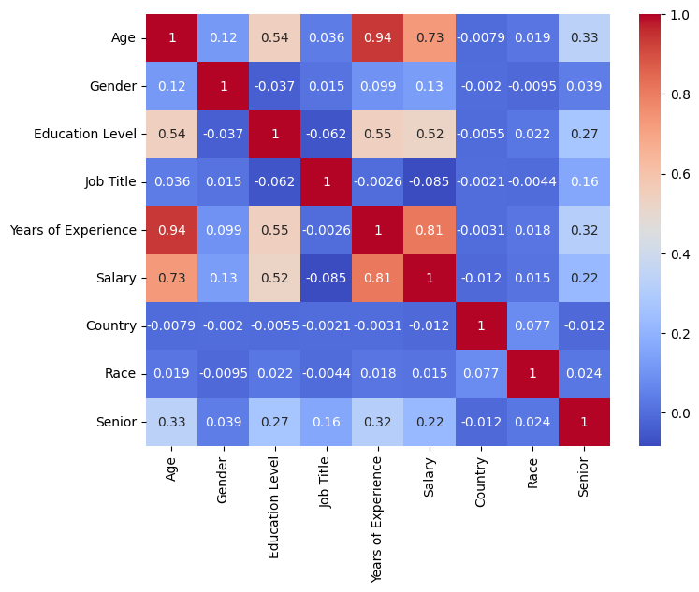
Q1
Generally, how does each feature correlate with each other?
Remarks
Age & Years of Experience (0.94)
Salary & Years of Experience (0.81)
Age & Salary (0.73)
Years of Experience & Education Level (0.55)
Age & Education Level (0.54)
Salary & Education Level (0.52)

Slide 5
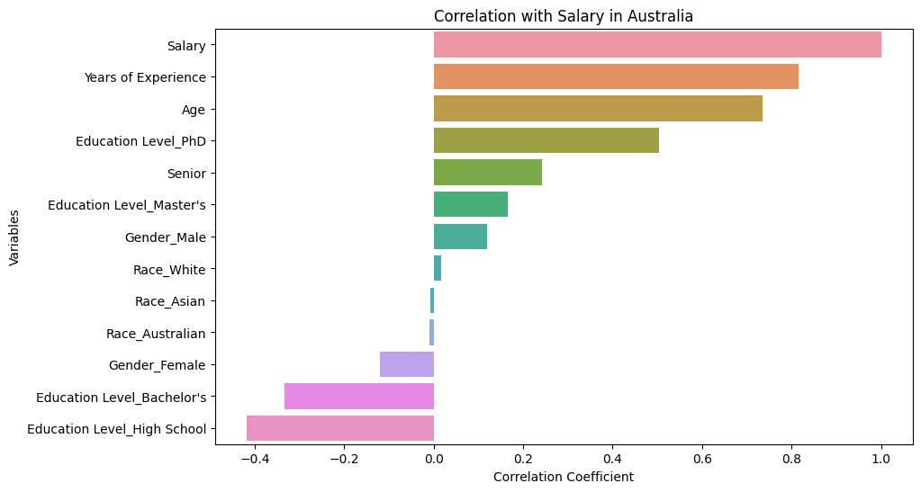
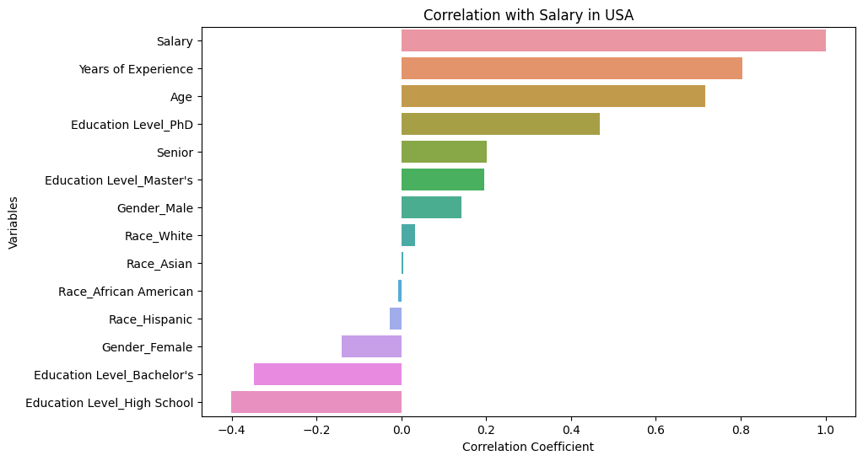
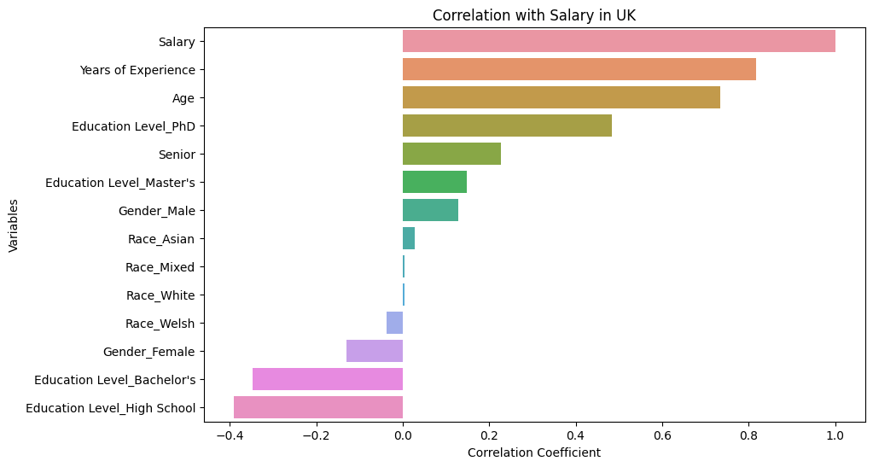
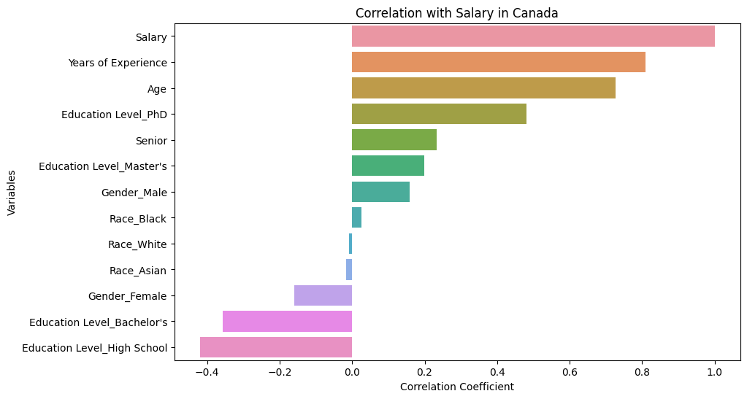
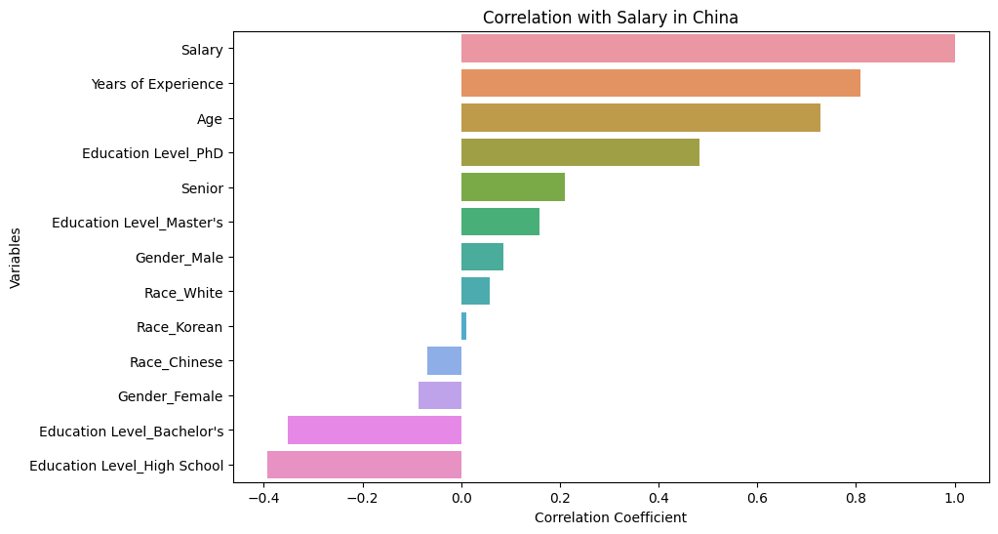
Country Comparisons

Slide 6
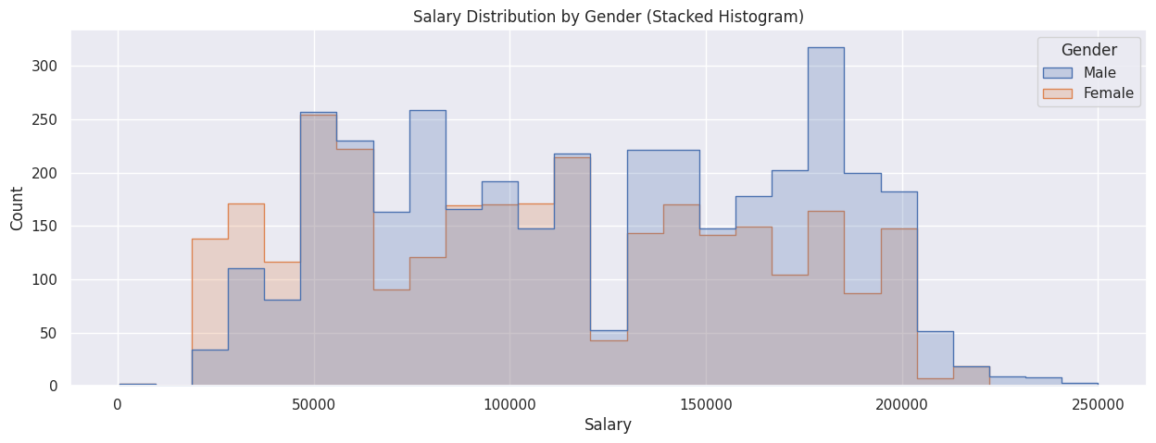
Q2
How are salaries distributed among males and females? Does the Gender Pay Gap exist?

Slide 7
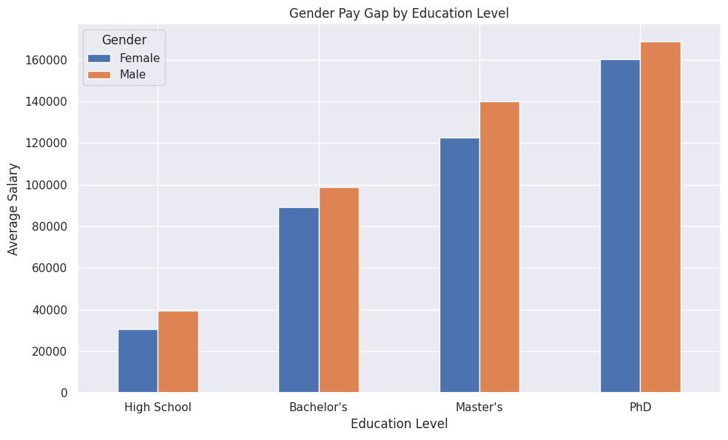

Is there a Gender Pay Gap across various education levels and years of experiences?
On average, males earn more than females, and this difference is present across various education levels and years of experience.

Slide 8
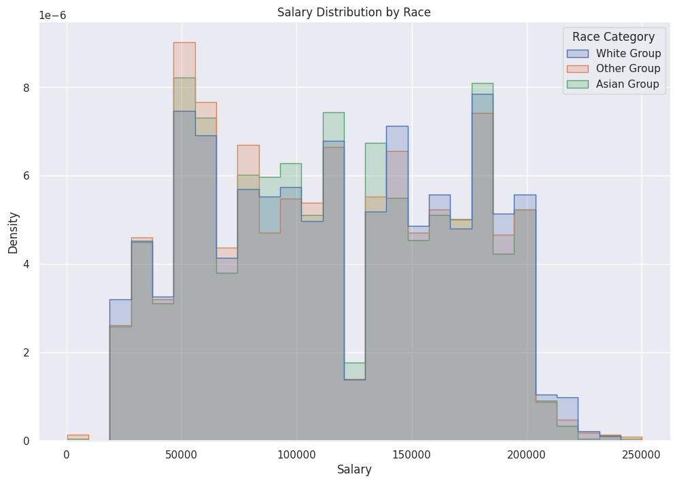
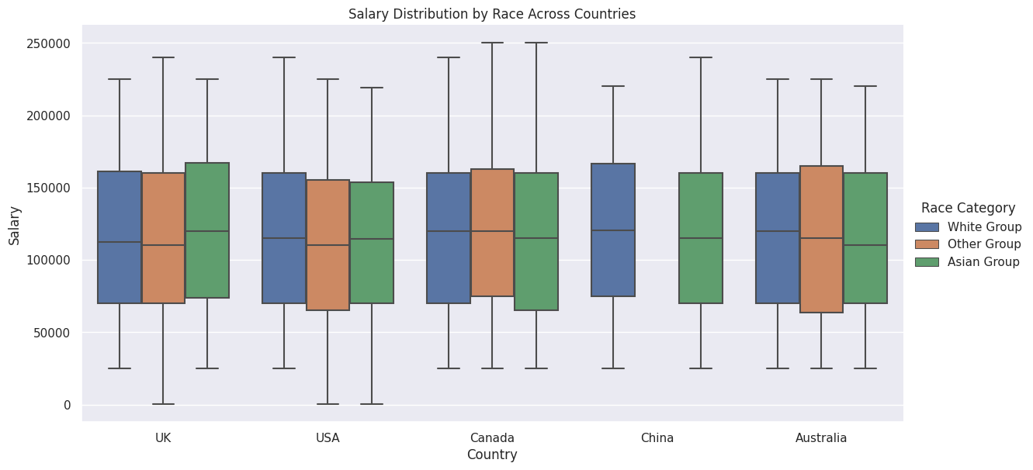
Q3
Group by Asian, White, and Other Races; How are salaries distributed among different racial groups? In which country, Asians (since we identify ourselves as Asians) earn the highest salary?
Asian relatively have higher concentration of individuals earning in middle salary range(75,000 - 14,0000). On average, Asians earn the highest salary in UK.

Slide 9
Q4
For jobs in Data Industry(Data Analyst, Data Engineer, Data Entry Clerk, Data Scientist, Chief Data Officer), which country (China or USA) has relative higher salary?

Slide 10
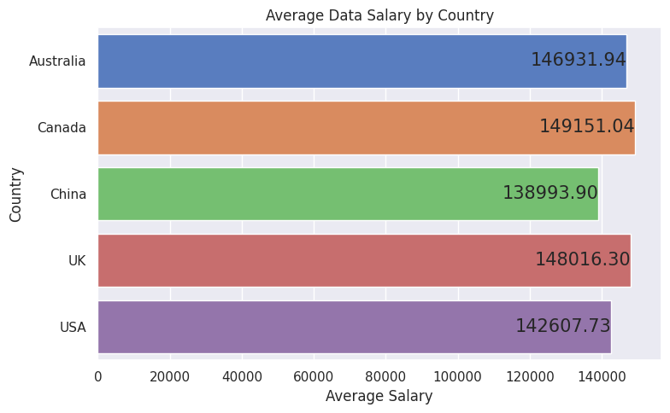
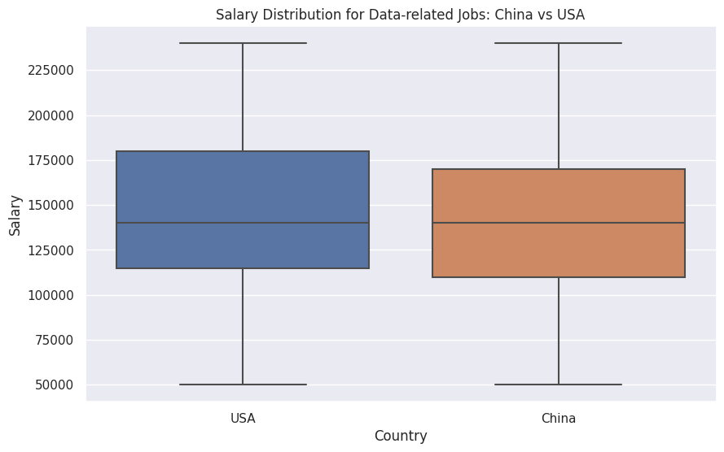
👈 Average Data Salary by Country
Average Data Salary in China & USA are relatively lower than the other countries
Salary Distribution: China vs USA👉
No obvious pay gap between two countries

Slide 11
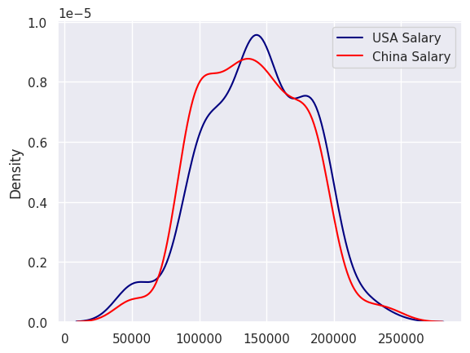
Hypothesis Test 1: Is there a significant difference on Data Industry payment in China & USA?
H0: There is no significant difference in Data industry payment in USA and China.
H1: Data industry jobs earn more in USA than China
P-value = 0.11597032 > 0.05
Fail to reject the null hypothesis.
Conclusion: There is no significant difference of Data industry payment in USA and China.

Slide 12
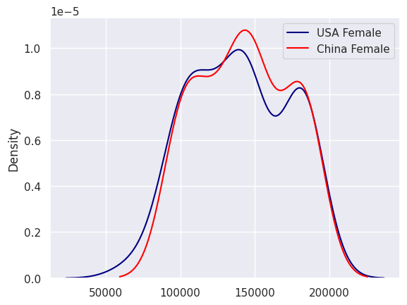
Hypothesis Test 2: Is there a significant difference on Data Industry payment for female in China & USA?
H0: There is no significant difference in Data industry payment for female in USA and China.
H1: Female in Data industry earn more in USA than China
P-value = 0.71771199 > 0.05
Fail to reject the null hypothesis.
Conclusion: There is no significant difference in Data industry payment for female in USA and China.

Slide 13
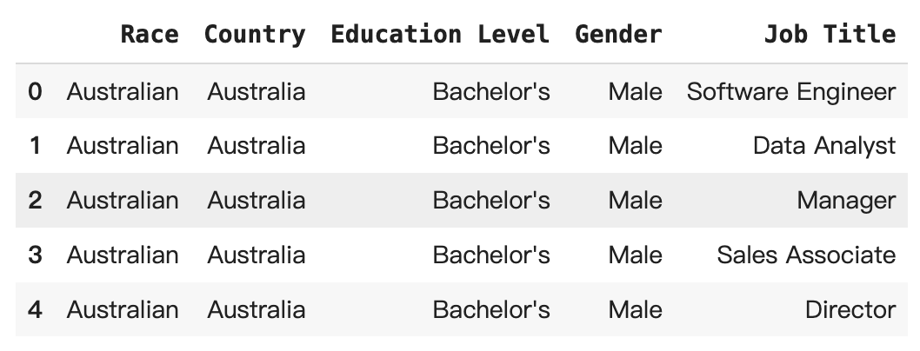
Machine Learning Models For Prediction
Predictors (X): ‘Race’, ‘Country’, ‘Education Level’, ‘Gender’, ‘Job Title’
Exclude strongly positive correlated features: ‘Age’, ‘Years of Experience’, ‘Senior’
Exclude duplicate feature: 'Race Category'
Target (Y): ‘Salary’
80% Test Data 20% Train Data
Models: Linear Regression Model & Random Forest Model
Data Used to Predict:
pairwise(‘Race’, ‘Country’) * ‘Job Title’ * ‘Gender’ * ‘Education Level’
Shape: (17544, 5)

Slide 14
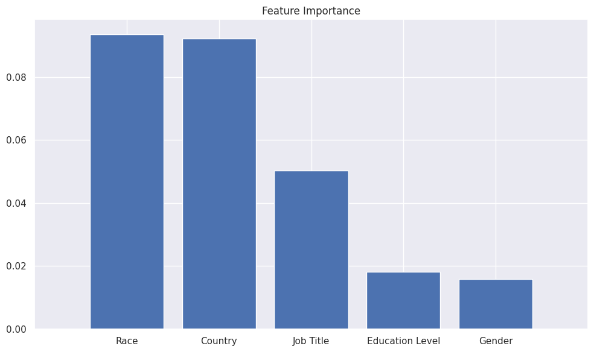
Linear Regression
Random Forest
R-squared: 0.638
Intercept: 98568.701
Coefficients:
Gender: -1915.106
Education Level: 1915.106
Job Title: -7739.664
Country: -35496.737
Race: 14747.958
R-squared: 0.639
Feature Importances
Gender: 0.0169
Education Level: 0.0173
Job Title: 0.0409
Country: 0.0921
Race: 0.1020
Conclusion of Prediction:
Choose to use Random Forest Model (2)
Asian, USA, Phd, Male, Chief Technology Officer
Predicted Salary: $218955

Slide 15
🏆100%🏆
Further Discussion
Model Improvement: Tuning hyperparameter to improve model performance or try more models.
Industry Trends: Every field is rapidly evolving, and industry demand can significantly influence salary.
Specific Skills: More specific data, such as skills, could offer more relevant insights.
Work Authorization: For international job search, work visa regulations and the ease of obtaining work authorization should be taken into account
Anti-discrimination Laws and Policies: Legal framework regarding employment discrimination in different countries can be important.

Slide 16
Thank you

